Slide 1
Deep Learning CA2 Part B
Jeyakumar Sriram (p2214618)
Shawn Lim Jun Jie (p2239745)

Slide 2
Contents
01
Objective
04
Model improvement
Explain the goal of our work
Finding ways to the improve model
02
Explore the environment
Model evaluation
05
Understand the problem that we are solving
Evaluate our final model
03
Implementation of DQN
06
Conclusion
Codes and explanation for building the DQN
Our final conclusion and thoughts

Slide 3
Objective
Build and train a DQN capable of balancing a pendulum in an upright position.
This is to be done in OpenAI’s Gym Pendulum Environment.
We achieved this by building a simple DQN and explore and experiment ways we can improve the model performance.

Slide 4

Exploring the environment
Observation space
OpenAI Pendulum Environment
Provides the coordinates and angle of the pendulum in (x, y, θ).
Action space
Model inputs a value (torque) to influence the environment (the pendulum swing).

Slide 5
Theory behind DQN
Q-learning
Deep neural network
Model-free algorithm for finding optimal policies for decision making in an environment.
The goal is to approximate the optimal action-value function.
Neural networks can be used as action-value function approximator.
Inputs the environment’s state and outputs Q-values for each action.
Experience replay
Loss function
DQN stores and randomly samples past experiences for learning.
The purpose is to break temporal correlation, making more stable learning.
A simple DQN defines loss as mean square error between predicted Q-values and target Q-value.
To minimise this loss value for more accurate Q-values prediction.

Slide 6
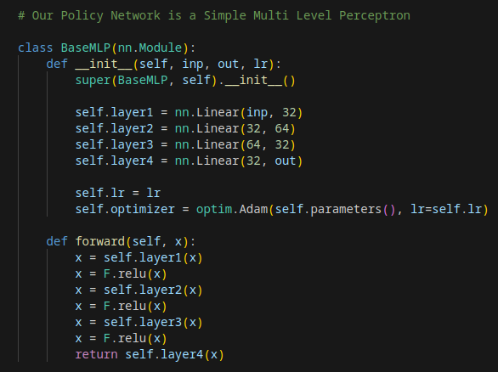
Simple DQN implementation
Built a simple Multi Layer Perceptron (MLP) which will be the “brain” of the agent.

Slide 7
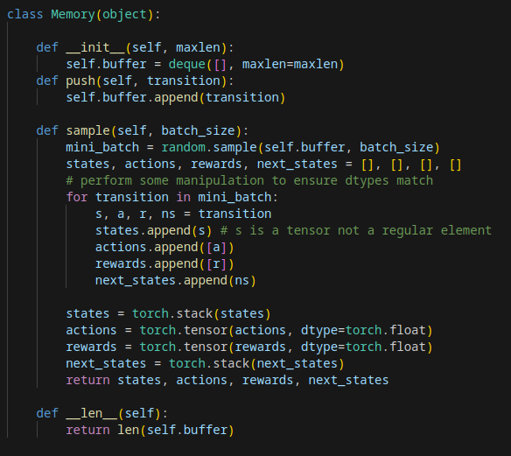
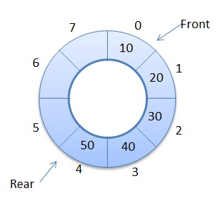
Simple DQN implementation
Circular buffer is used to store past experience.
Agent will sample random past experience to learn.
Agent will not be using very old data to learn, hence a circular buffer where new data overwrites the old when the circular buffer is full.

Slide 8
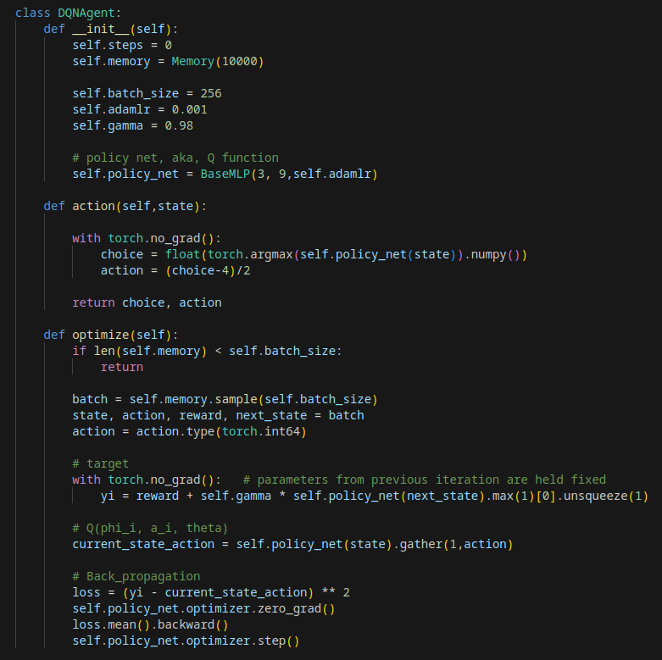
Simple DQN implementation
A simple DQN agent powered by the MLP we shown just now.
It will output the an action based on the highest Q-value by inputting the action method with a state.
Optimises itself by random sampling past experiences and calculate loss values and back propagate.

Slide 9
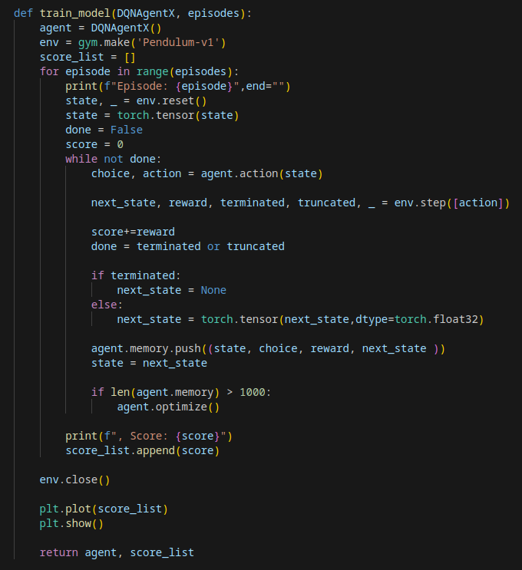
Simple DQN training
For training, the agent will output an action for the environment, and the environment outputs the next state and reward.
The state, agent’s choice, reward, and next state are appended into the memory.
After the memory reaches a certain size, the agent starts optimising.

Slide 10
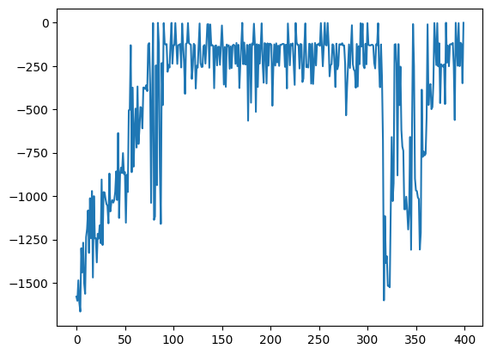
Simple DQN training
The graph on the right shows the score of the agent performance.
The score is calculated by the sum of all the rewards in each episode.
The model took around a 100 episodes to be good.
The model suffers from “Catastrophic Forgetting” after 300 episodes.

Slide 11
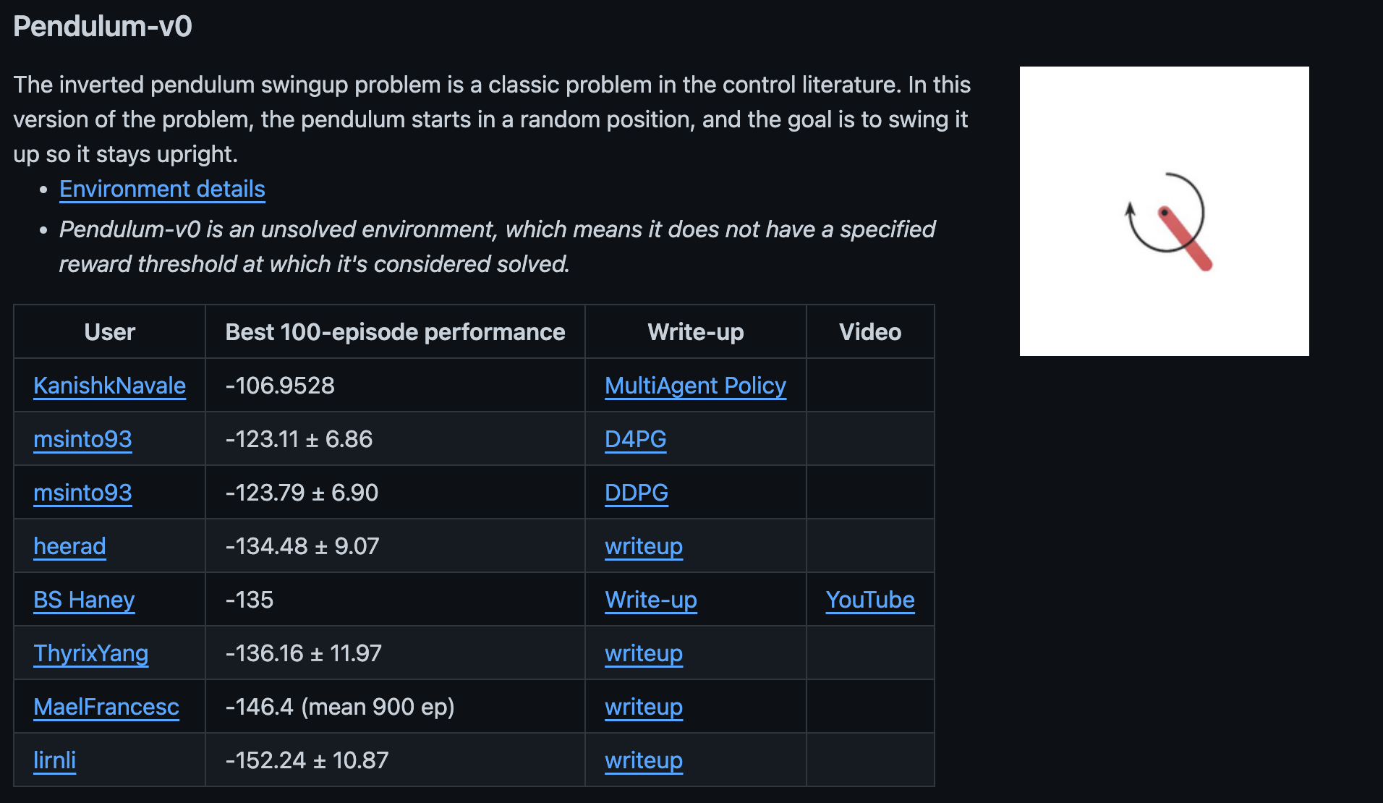
Simple DQN score comparison
When computing for the average 100 episodes score, we got -215. And when comparing to the best performant models, we are not far from the leaderboard, even for a basic model.

Slide 12
Simple DQN visualisation observation
Observations
Issues
Potential solutions
Model is able to balance the pendulum well.
Suggesting that a simple model is capable of learning effectively.
The model tends to apply huge amount of torque to maintain the position of the pendulum after reaching the top.
Due to the model not getting enough discrete actions and a lack of action that produces near 0 torque.
Increase action array size
Increase the number of discrete actions.
Provide the model more unique options to apply force.
Quadratic spread
Make the action array quadratic in spread
Allows for more nuance control near zero torque.
Notes:
Sup

Slide 13
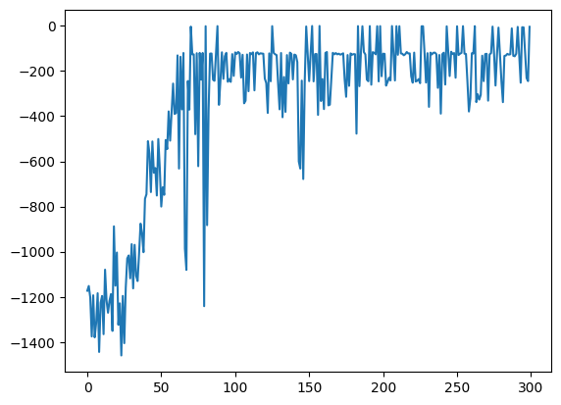
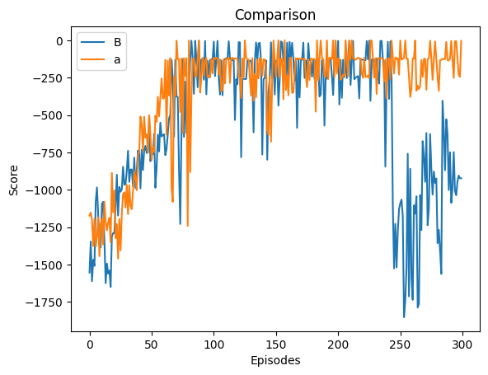
Model improvement (Best practices)
Use Leaky ReLU instead of the normal ReLU
Allows for non-zero gradient for negative inputs
To address the dying ReLU problem
Score for improved model
Score for original vs improved model

Slide 14
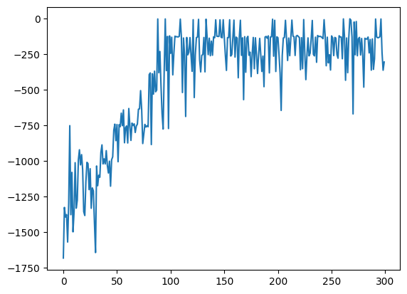
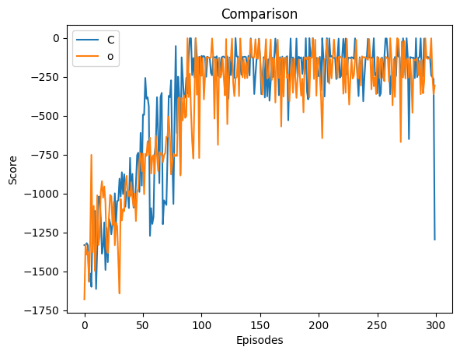
Model improvement (Training stabilization)
Greedy Epsilon
Gives model the ability to exploit the best known action, or explore with random action.
To prevent model from converging a suboptimal policies, or “local minimum”.
Gradient Clipping
Capping the minimum or maximum gradients to prevent extreme parameters updates.
To mitigate instability issues such as exploding gradients.
Score for improved model
Score for Leaky ReLU vs current improvement

Slide 15
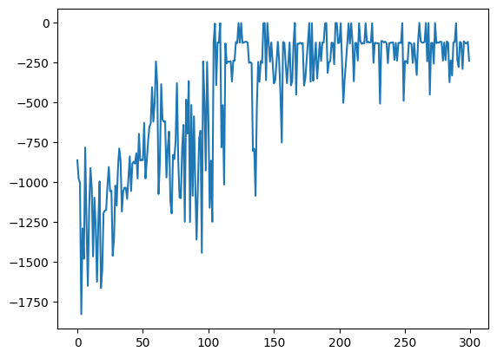
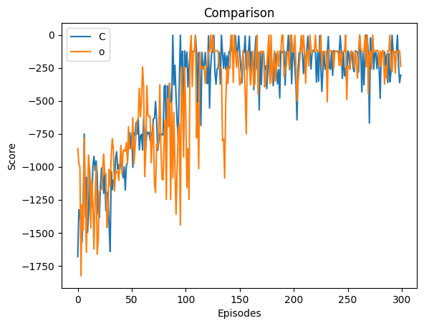
Model improvement (Enhanced action space)
Increase action array size
Gives the model more discretise input.
Can potentially provide a better baseline.
More concentrated discrete values around 0
By applying quadratic or exponential distribution of action values.
Gives the model more nuanced options around 0.
Score for previous improvements vs current improvement
Score for improved model

Slide 16
Double DQN
The problem
The solution
Simple DQN uses the same network for both selection and evaluation of actions.
Can potentially lead to overestimation of Q-values.
Implement Double DQN by having two separate networks.
One of them for selecting best action, another for evaluating that action’s Q-value.
The action
A separate MLP for evaluating Q-values of selected actions.
Parameters for both MLPs will be the same at first, and will be synchronised periodically.

Slide 17
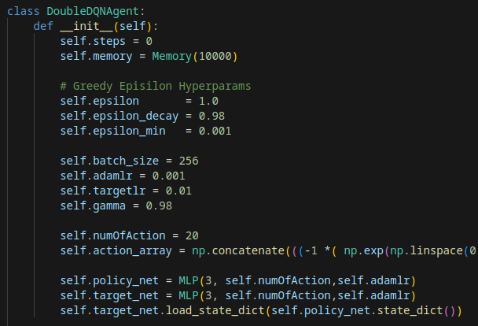
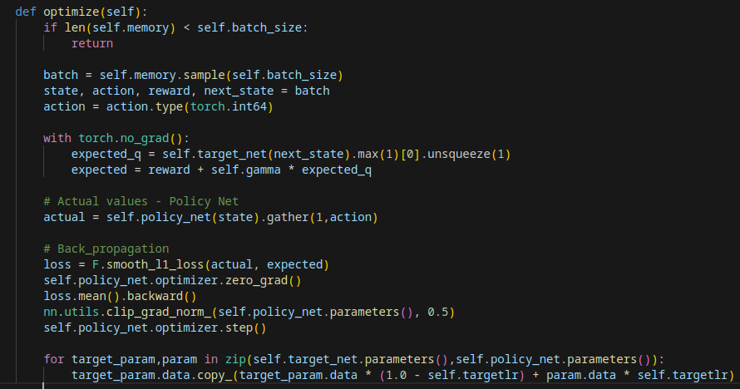
Implementing Double DQN
Modifying the agent to have two MLPs: policy and target network
Modifying the optimiser to for the target network to evaluate.

Slide 18
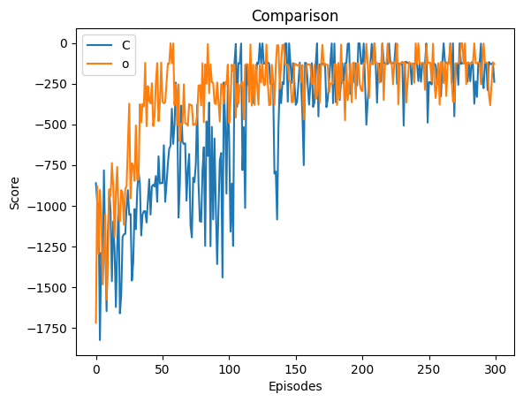
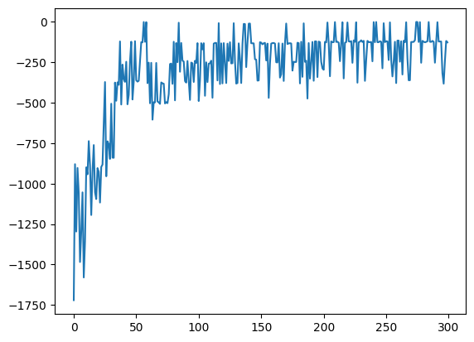
Double DQN result
The result of Double DQN shows that:
The model learn very fast, reaching around -250 score in 50 episodes.
The score graph looks generally stable.
With the evaluation score (100 episodes average) of -150, it’s right on the leaderboard of the Pendulum Problem.
Conclusion: Double DQN is far better in our scenario.
Score for previous simple DQN vs Double DQN model
Score for Double DQN

Slide 19
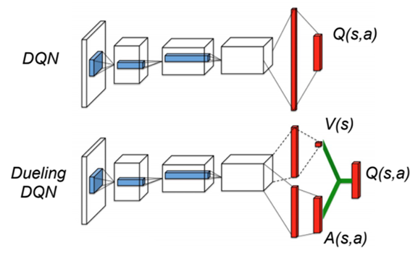
Dueling Double DQN
By having two separate sequential linear layers as shown on the right, where one will output the value, while the other output a series of advantages, then we have a dueling DQN.
Couple with our Double DQN, we have the Dueling Double DQN.
We want to see if having two separate layers can improve the performance by letting the model know the value of each state.

Slide 20
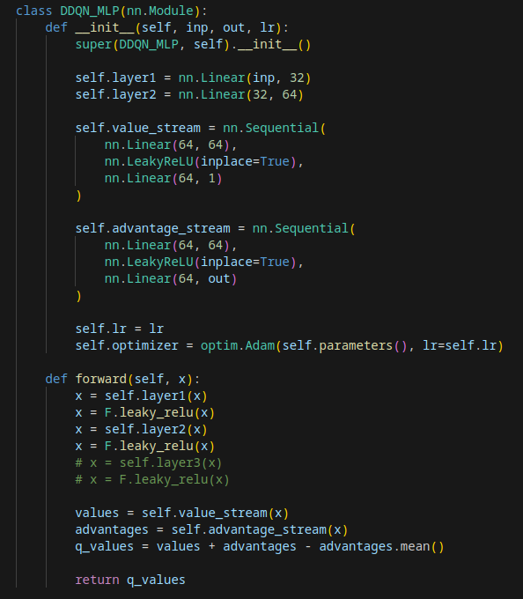
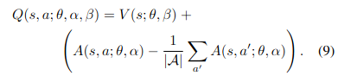
Implementing Dueling Double DQN
Simply create two sequential layers, one will output one feature, the value stream, and another will output the size of the action array provided, the advantage stream.
When combining the values and advantages, we can’t just simply add them, we add them and minus the mean of the advantage, according to the formula on the paper for Dueling DQN.
Formula for combining value and advantage:
Notes:
Sup nigga

Slide 21
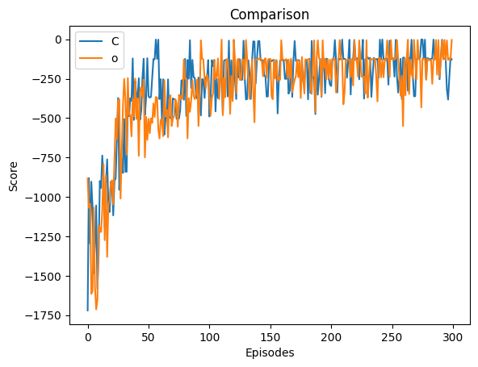
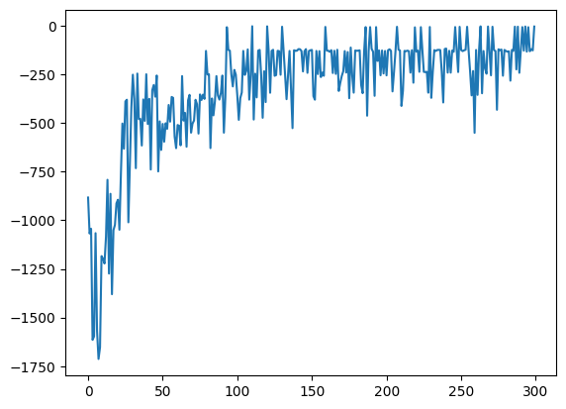
Dueling Double DQN result
The result of Dueling Double DQN shows that:
For this pendulum problem, it is not an improvement compared to Double DQN, based on the score comparison.
Having an advantage and value streams does not seem to provide an advantage for this simple environment.
Conclusion: Continue using the Double DQN for our scenario
Score for Double DQN vs Dueling Double DQN
Score for Dueling Double DQN

Slide 22
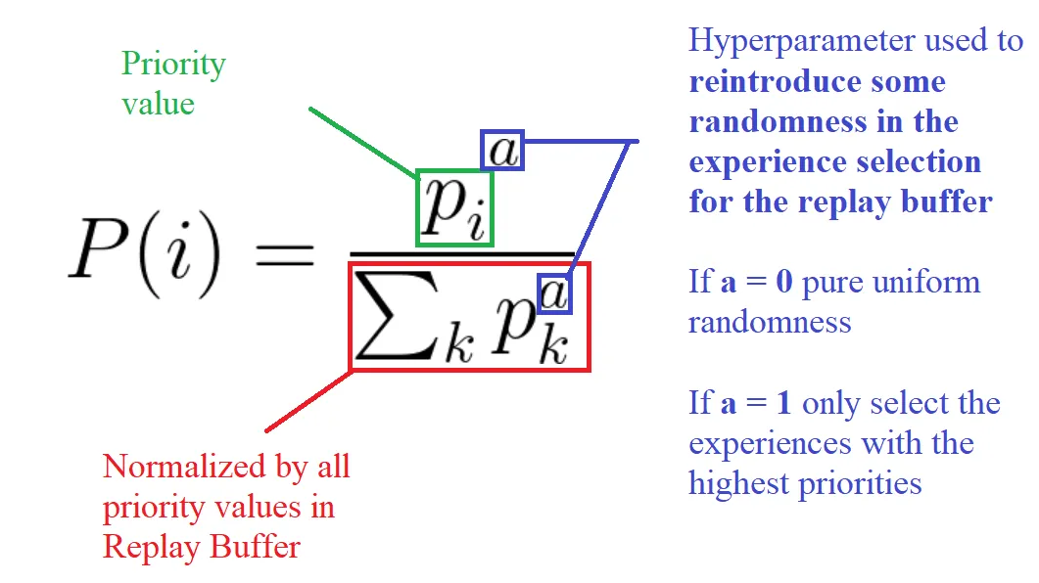
Further model improvement (Enhanced memory sampling)
By using Prioritised Experience Replay:
We assign priority values to each experience.
Experiences with higher learning potential (higher TD error), are assigned higher priority values.
When sampling for experiences, those with higher priority values will be more likely to be sampled for learning.
However, experiences with lower priority values will be ignored. Hence, there will be an element of probability to ensure higher priority values will get higher chance while smaller priority values small chance, giving all experiences the chance to be used. This also comes with a hyperparameter a to adjust the randomness, as shown on the right.

Slide 23
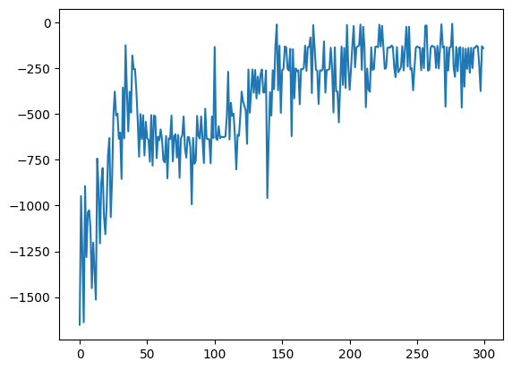
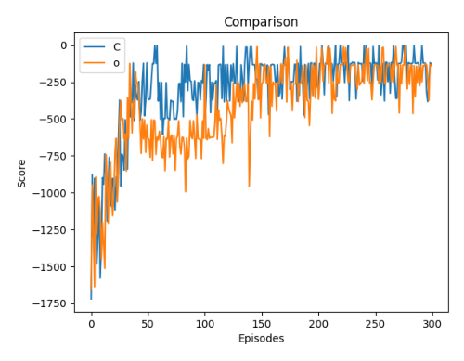
Model improvement result (Enhanced memory sampling)
The results for this improvement shows that:
It took more epochs for the model to converge.
No increase in performance compare to using random sampling.
Given the simplicity of the pendulum environment, this improvement does not provide any benefits.
Conclusion: Regular random sampling simply works well for this scenario.
Score for this improvement
Score for before vs after

Slide 24
Further model improvement (Noisy net)
Lastly, we will also try out another way to let the model balance between exploration and exploitation.
By introducing a noisy layer on the output of the MLP, we can take advantage of the follow benefits:
Epsilon-greedy strategy might not be sufficient enough in complex environment.
As this is a parameterisable layer, it allows the model to adjust the noise for appropriate situations.
The noise is able to introduce randomness on the action selection, making it less prone to overestimation bias.

Slide 25
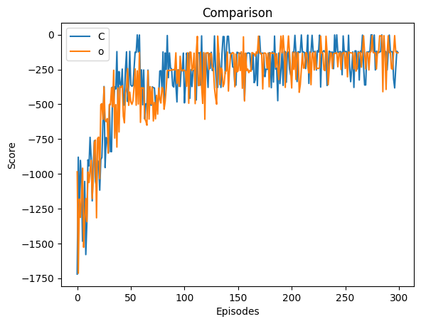
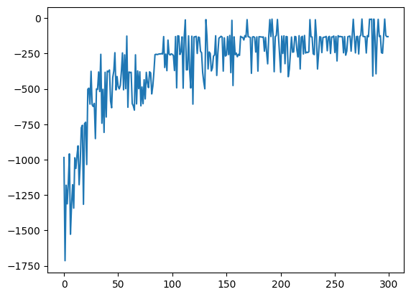
Model improvement result (Noisy net)
Improvements: Although the graphs look very similar for both, the Noisy DQN has a slightly higher 100-epoch average. It consistently ranks higher than the previous model

Slide 26
Our final model
01
02
Dueling
Gradient clipping
Fix over Estimation of Q Value
Double DQN
Mitigate instability issues
Two networks: One for action, another for evaluation
03
04
Exponential action array
Noisy net
Allows for more nuanced action near zero torque.
More efficient way to give exploration or exploitation for agent

Slide 27
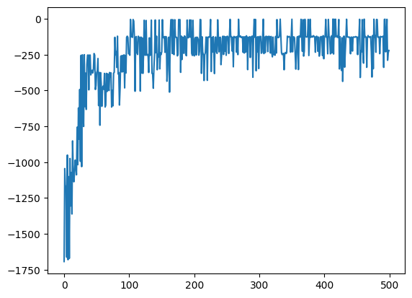
Our final model evaluation
Consists of mostly basic model improvement.
Converge at around 100 episodes.
On evaluation, it achieved a 100 epoch average score of -170.
This score is very close to the global highscore of -100
This model can be even better if we use more advanced architectures like A3C. This is because DQNs are primarily designed for discrete problem where you have a set number of possibilities. That is what a Q function is about. When we use it for continuous value prediction problems like this, the model will definitely face limitations.

Slide 28
Conclusion
We have learnt how to develop DQN in reinforcement learning.
The simple DQN was initially unstable, but basic model improvements help to mitigate the issues.
After the introduction of the Double DQN, any further model improvements were unnecessary due to the simplicity of the pendulum environment.
Hence, we learn that the techniques used for reinforcement learning should align to the complexity of the problem we are solving. A simple technique is enough for a simple problem.

